Slide 1
Probability Applications

Slide 2
24
7
30
Date
Probability Applications
EQ – Describe three real life situations where probability must be used?
9

Slide 3
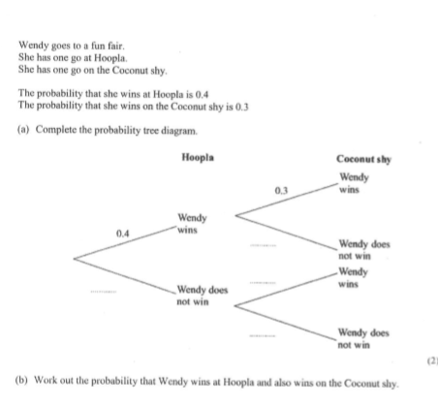
Revision

Slide 4
24
7
30
Date
Probability Applications
EQ – Describe three real life situations where probability must be used?
What is Probability Application?
Probability application means using probability in real life
situations to solve or understand real world problems.
For example:
-The Eagles probability of winning the flag.
-Analyse trends in biology (e.g. disease spread)
9

Slide 5
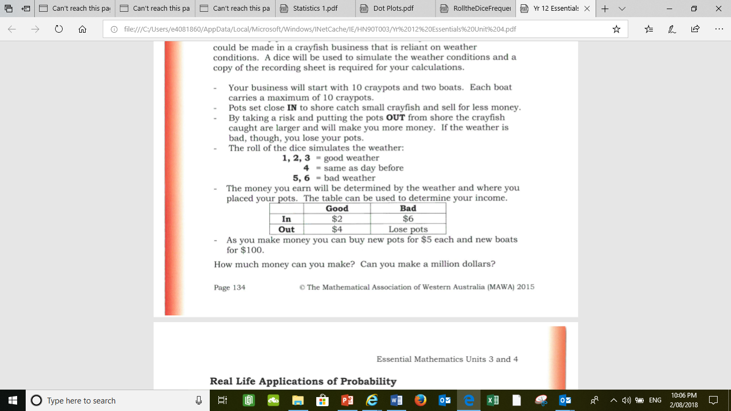
Worksheet Craypots
The rules:
The goal is

Slide 6
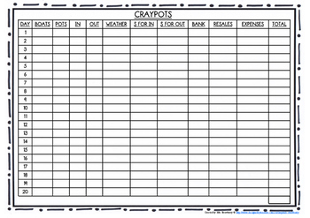

Slide 7
Textbook Questions:
Questions 2 – 7 on pages 135 - 138

Slide 8
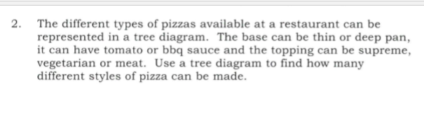

Slide 9
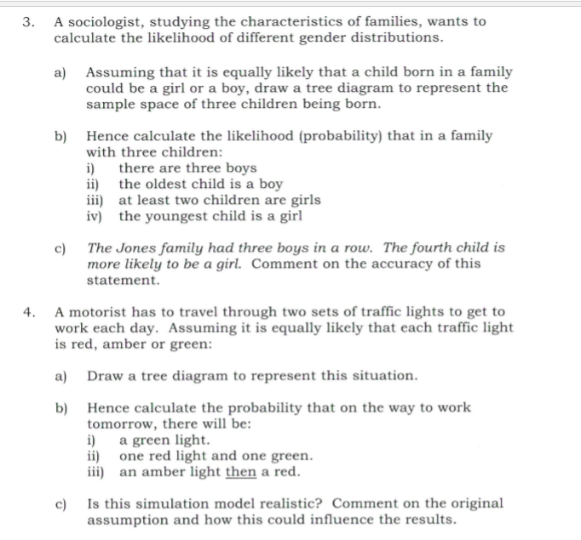

Slide 10
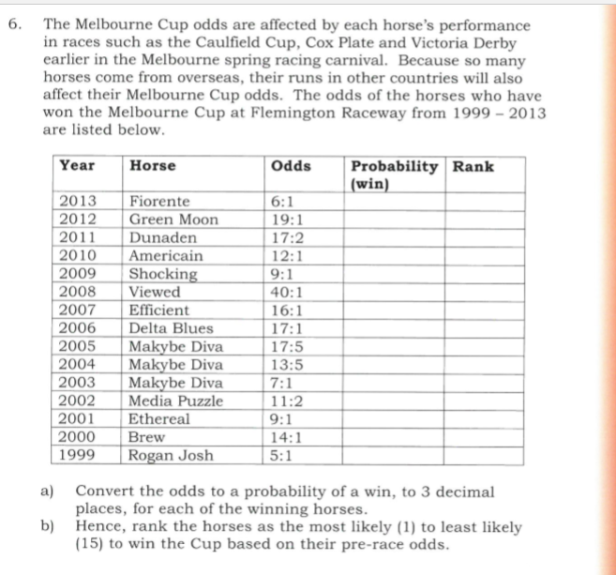

Slide 11


